Slide 1
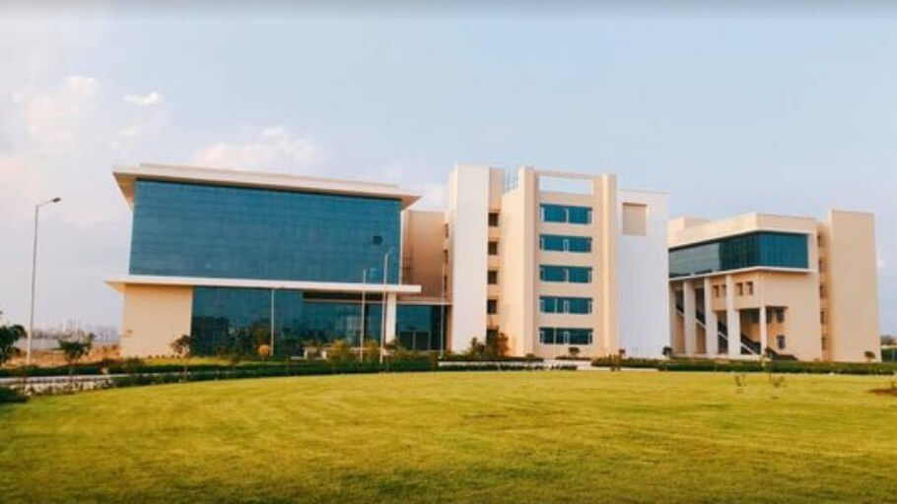

A GLOSMAN-2024 National Conference on Sustain-Fluence : Navigating the landscape of sustainable marketing through social media influencers
Presented by: Shiwangi Singh, Dyovan Madhav, Hrishabh Shukla, and Shefali Srivastava
Indian Institute of Information Technology, Lucknow

Slide 2



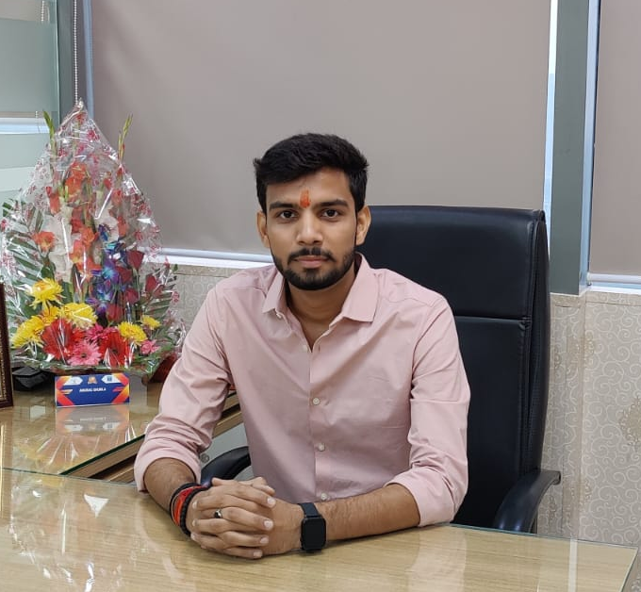

Details of Authors
Author 1
Author 2
Author 3
Author 4
Shiwangi Singh
MBA (Digital Business) Student
Department of Management &
Humanities
IIIT LUCKNOW
mdb23026@iiitl.ac.in
https://www.linkedin.com/in/shiwangi-singh-155463293
Dyovan Madhav
MBA (Digital Business) Student
Department of Management &
Humanities
IIIT LUCKNOW
mdb23024@iiitl.ac.in
https://www.linkedin.com/in/dyovan-madhav
Hrishabh Shukla
MBA (Digital Business) Student
Department of Management &
Humanities
IIIT LUCKNOW
mdb23002@iiitl.ac.in
https://www.linkedin.com/in/
hrishabh-shukla-463275291
Shefali Srivastava
Phd Scholar
Department of Management &
Humanities
IIIT LUCKNOW
rmh22102@iiitl.ac.in

Slide 3

Table Of Content
Problem Statement
Background study
Objective
Results & Findings
Conclusion
Further Questions

Slide 4

PROBLEM STATEMENT
How does the increasing influence of social media and influencers in the digital era impact the promotion and adoption of sustainable practices, products, and lifestyles?

Slide 5

OBJECTIVE
1. Analyze how influencers leverage their reach to champion sustainable practices, products, and lifestyles.
1
2. Evaluate the impact of social media on shaping the discourse around sustainability.
2
3. Investigate the role of influencers in disseminating eco-friendly initiatives and advocating for environmentally conscious choices.
3
4. Explore the contribution of social media platforms in fostering a sense of environmental responsibility among users.
4

Slide 6

BACKGROUND OF STUDY
Social media is a powerful tool for communication and marketing in the digital era.
Businesses can enhance their online presence and contribute positively to the planet through social media.
This study focuses on how influencers use their reach to promote sustainability.
It explores the impact of social media on shaping sustainability discourse.
Influencers play a role in disseminating eco-friendly initiatives and advocating for environmentally conscious choices.
The study also looks into how social media platforms contribute to fostering environmental responsibility among users.

Slide 7
INFLUENCERS

Slide 8
Pankti Pandey (zerowasteadda)
Advocates zero-waste living.
Raises awareness about waste reduction practices.
Engages followers through challenges and discussions.

Slide 9
Nayana Premnath
Promotes eco-friendly products and ethical consumerism.
Showcases sustainability in style choices.
Utilizes a visual and relatable approach.

Slide 10
Akash Ranison
Champions environmental causes on social media.
Participates in and organizes campaigns for climate change.
Connects with followers through storytelling and personal experiences.

Slide 11
FINDINGS
1
2
3
Impact on Sustainability Discourse
Dissemination of Eco-Friendly Initiatives
Fostering Environmental Responsibility

Slide 12
Impact on Sustainability Discourse
Influencers shape sustainability conversations online.
Diverse approaches broaden the reach of eco-friendly messages.
Collective impact reinforces the importance of sustainability.

Slide 13
Dissemination of Eco-Friendly Initiatives
Influencers spread information about eco-friendly initiatives.
Creative content and collaborations amplify visibility.
Bridge gap between awareness and action.

Slide 14
Fostering Environmental Responsibility
Build a community of environmentally conscious followers.
Social media platforms catalyze environmental responsibility.
Inspire users to adopt sustainable behaviors for positive change.

Slide 15
ANALYSIS & RESULTS

Slide 16
Strengths
Relevance to current societal concerns
Inclusion of diverse influencers
Offers practical insights for sustainability promotion
Weaknesses
Subjectivity in interpreting influencers' impact
Limited generalizability due to specific focus
Vulnerable to the dynamic nature of social media trends
Opportunities
Informing policies for influencers and businesses
Collaboration opportunities for sustainable initiatives
Educational outreach based on study insights
Limitation
Risk of influencers being perceived as inauthentic
Impact of changing algorithms on social media platforms
Competition from conflicting narratives in sustainability messaging

Slide 17
Major Highlights
Case study highlights the influential connection between social media influencers and sustainable marketing.
Examined influencers like Pankti Pandey, Nayana Premnath, and Akash Ranison.
Noted their impact on sustainability discourse through diverse audience engagement and promotion of eco-friendly practices.
Emphasized the opportunity for businesses in sustainable marketing through authentic influencer collaborations.
Recognized influencers as catalysts shaping consumer choices and fostering a collective commitment to a more sustainable future.

Slide 18
REFERENCE
https://www.femina.in/trending/achievers/pankti-pandey-a-leading-voice-in-zero-waste-living-276968.amp
https://www.nayanapremnath.com/
https://aakashranison.com/
Routledge International Handbook of Sustainable Development - Google Books

Slide 19


THANK YOU
FURTHER QUESTIONS?
Shiwangi Singh
https://www.linkedin.com/in/shiwangi-singh-155463293
Dyovan Madhav
https://www.linkedin.com/in/dyovan-madhav
Hrishabh Shukla
https://www.linkedin.com/in/hrishabh-shukla-463275291

